Slide 1

A New Social LIFE FINAL PROJECT
SHELSY DALCIDE
06/08/2020

Slide 2
Problem
Leave home sound to go live in Illinois A young man would like in Illinois to rebuild his life This project will be useful for people wishing to leave their countries to live in Illinois. He would like to have additional information so quickly regarding districts.

Slide 3
Data acquisition and cleaning
Going to live in another place and adapting for its analysis we were able to extract data on the wages of each city in Illinois.
We had dataset on the population of each city by web scrapping.
The dataset on crime in each city by web scrapping.
And the dataset of house prices in each city that we downloaded and not extracted.
In Total we have for the population dataset we have two(2) columns and one thousand two hundred and three(1203) lines.
In total for salary data per year in every city in Illinois we have two(2) columns and one thousand three hundred and fourteen(1314) lines.
In total for the dataset of house prices we have three hundred and two(302) columns and twenty-six thousand eight hundred and nineteen(26819) lines
And for the crime dataset we have twenty-five(25) columns and ninety-seven(97) lines.
Duplicate, highly similar or highly correlated features were dropped.
Cleaned all these data.

Slide 4
methodology
The State of Illinois, is the most populous city in the U.S. state of Illinois, and the third-most-populous city in the United States. With an estimated population of 2,693,976 in 2019, it is also the most populous city in the Midwestern United States.
Our job is to help someone moving to Illinois to find a house in a safe area so that they are comfortable and at an adequate price after getting information about the wages of people living in Chicago. For our work we did the web scrapping to extract data of population and the salary we needed for our Analysis.
Data Preprocessing is for transformed, or Encoded, to bring it, clean our dataset, select all columns we need for our Analysis, make analysis of the crime of each county and region in Illinois, filter our data in order to mix them, Make analysis for each dataset see the crime rate in Illinois cities and the rate of the (burglary, murder and sexual assault..) see if they are similar. Make graphs to see the thirty (30) cities where average house prices are very high

Slide 5
methodology
Remove duplicates and the missing values in each dataset . convert the salary columns of the cities into a float in order to make calculations to see the salaries in average their variance the minimum and maximum salaries.
We would like to have some data found in foursquare so we can see some closer to home such as (church, school, restaurant, movie theater, super market...)
Show him the venues (church, school, restaurant, cinema, supermarket...) via a map.
Since our dataset contains the house prices per month from 1996 to 2020, we will filter the columns of the last two years from 2018 to 2020.
Recommend him what salary he could get living in Illinois depending on the town.
Use the Clustering method to make an Unsupervised Learning Machine.

Slide 6
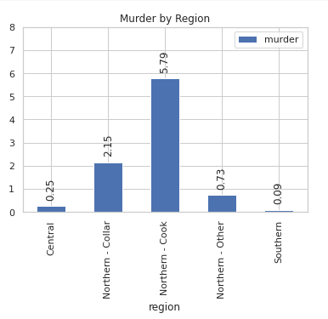
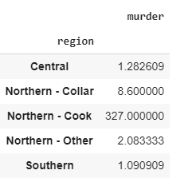
Results type of crime by region
Here we have in this table we have the amount of murder in his area. And the graph shows us the murder rate in each of his regions and we can see that the region Northern-Cook contains more murders than the others above he’s about 327 murder in the year 2018. The region Southem is the one with the least crime, he’s about one crime.

Slide 7
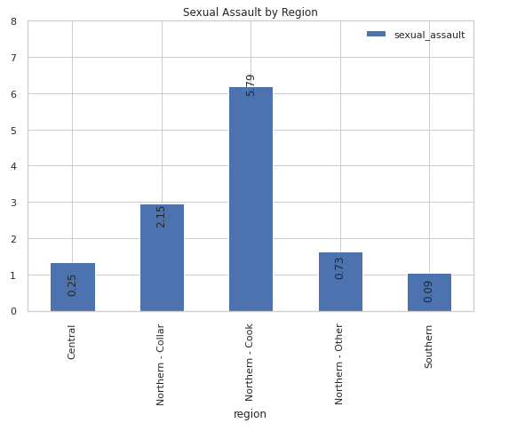
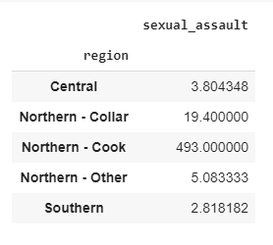
Results type of crime by region
By region we have noticed that the region of Northem-Cook and Northem-Collar contains a Sexual Assault lot more than the others.
Northem-Cook on average the quantity of Sexual Assault is 393 in the year 2018
Northem-Collar on average have 19 sexual assault in the year 2018
The Southem and the central are the one with the least Sexual Assault one is about 2 and the other is about 3 sexual assault on average in the year 2018

Slide 8
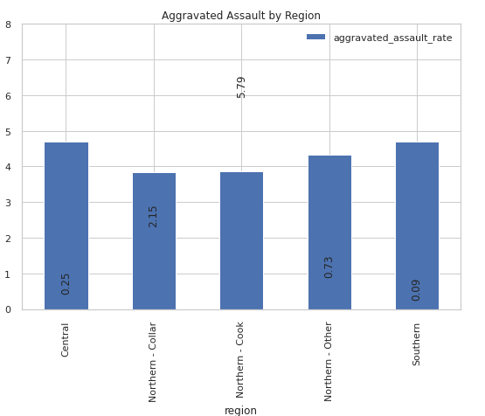
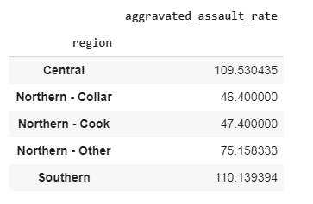
Results type of crime by region
Southem which has the highest rate of aggravated assault about 75 aggravated assaults on average
The Northem –Collar which has the lower rate of aggravated assault about 46 aggravated assaults on average

Slide 9
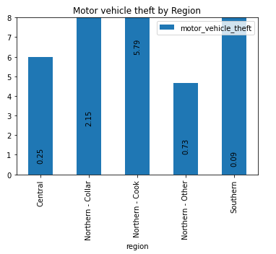
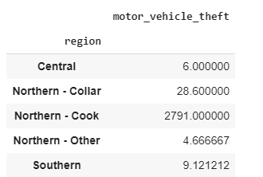
Results type of crime by region
Here the Northem-Cook contains on average 2791 motor vehicle theft more than Northen-Collar who contains 28 motor vehicle theft
And Northem-Other and the Central contains on average the least one contains 4 motor vehicle theft and the other contains 6 motor vehicle theft

Slide 10
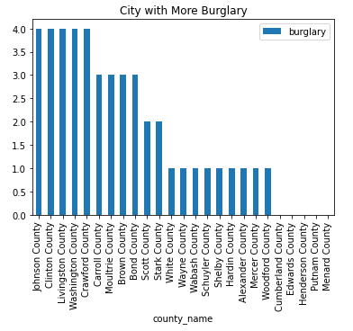
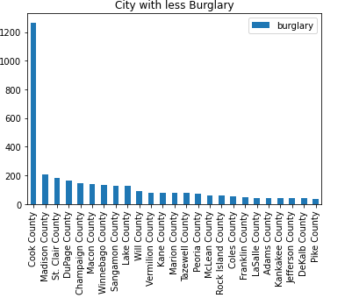
Results type crime by County
We wanted to see the crimes by county, and this type of crime is burglary. We can see the county with the fewest burglaries and the most burglaries we're going to identify. The county with a high burglary: Johnson County,Clinton County, Livington County Washington County,Crawford County. The county with a lower burglary: Pike County, Dekalb County,Jefferson County,Kankakee County,Adams County…

Slide 11
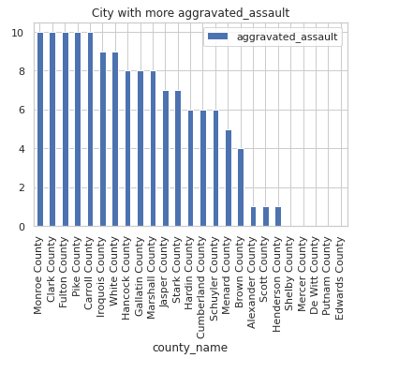
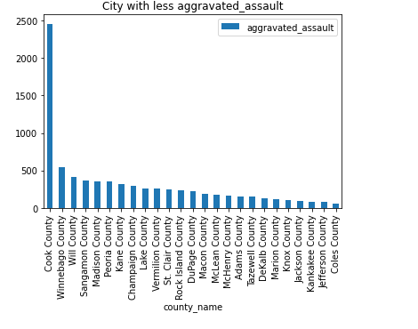
Results type crime by County
We wanted to see the crimes by county, and this type of crime is aggravated assault. We can see the county with the fewest and the most aggravated assault we're going to identify. The county with a high aggravated assault: Monroe County, Clark County, Fulton County, Pike County. The county with a lower aggravated assault: Coles County, Dekalb County ,Jefferson County, Kankakee County, Jackson County…

Slide 12
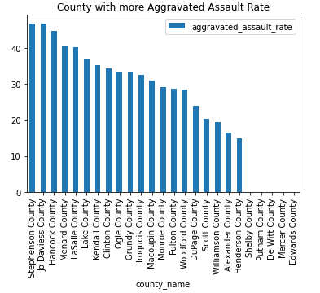
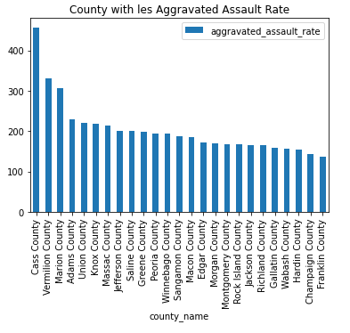
Results type crime by County
We wanted to see the crimes by county, and this type of crime is the rate aggravated assault. We can see the county with the fewest and the most aggravated assault we're going to identify. The county with a high rate aggravated assault: Stephenson County, Jo Daviess County, Hancock County. The county with a lower rate aggravated assault: Franklin County, Champaign County ,Hardin County, Wabash County, Gallatin County…

Slide 13
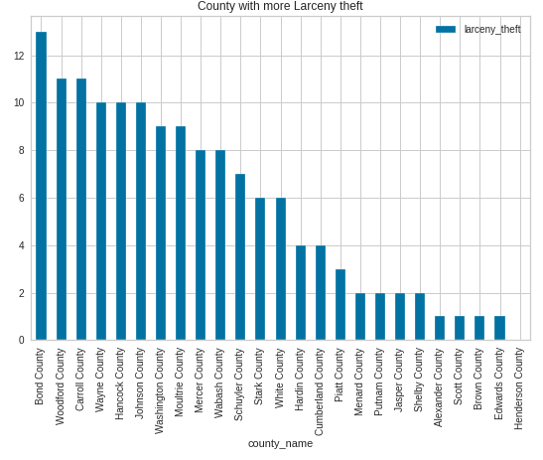
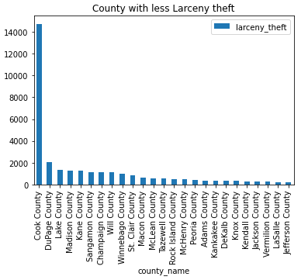
Results type crime by County
We wanted to see the crimes by county, and this type of crime is the Larceny theft. We can see the county with the fewest and the most larceny theft we're going to identify. The county with a high larceny theft : Bond County, Wooford County, Carrol County. The county with a lower larceny theft : Jefferson County, LaSalle County ,Vemilion County, Jackson County, Kendall County…

Slide 14
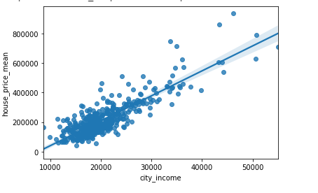
Results
Here this graph shows us the average house prices per city according to the average wages of the cities in Illinois we can say that as long as the wages of the person is high as he can pay a house in the cities of Illinois.

Slide 15
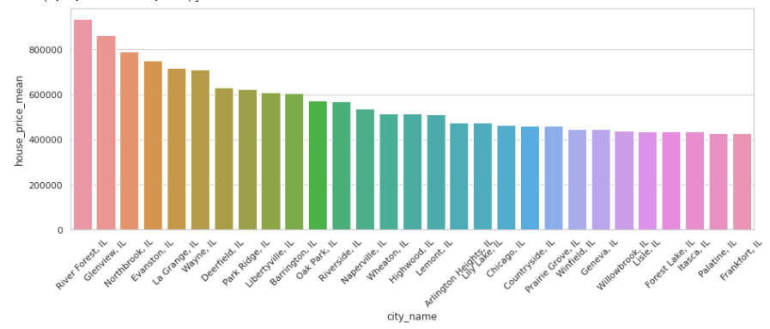
Results
For this graphical demonstration we have the top 30 cities with very high average house prices.

Slide 16
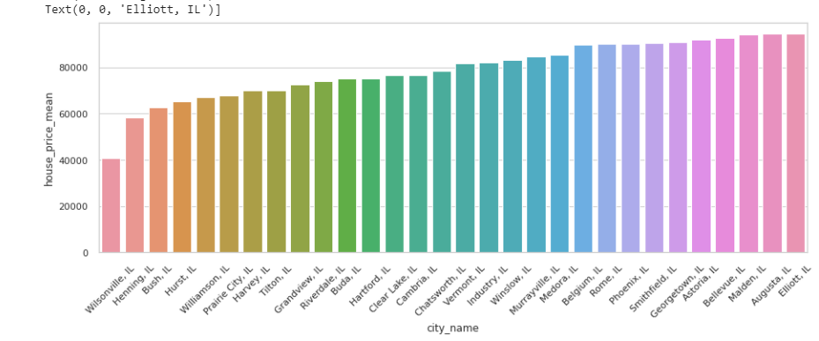
Results
For this graphical demonstration we have the top 30 cities with very lowest house prices in average

Slide 17
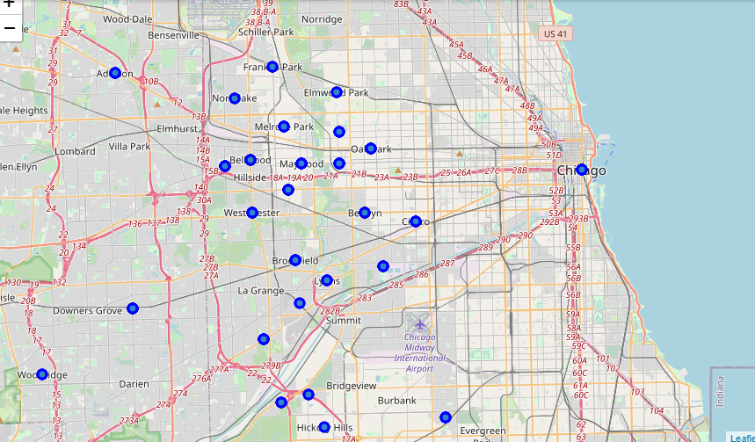
Results
Create maps for see the venues in each city

Slide 18
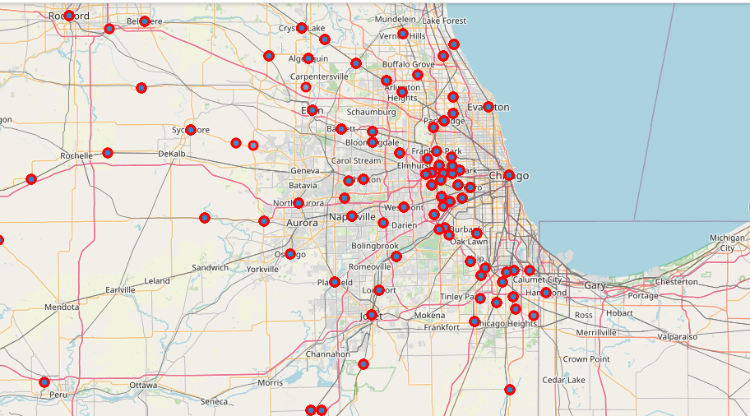
Results
Create maps for see the venues in each city

Slide 19
conclusion
After our analysis we noticed that the city of Illinois that has the cheapest house price is Wilsonville, IL. from where we can deduce that people will be able to settle more easily since the house prices are at least $40,000 whether the person has an adequate salary or not he will be able to enter this city which will be easier for him to find a house and his other usual places in his previous city, so that he can start a new life.

Slide 20
References & recomendation
https://github.com/shelsyayiti/Ayiti_Analytics_ShelsyDalcide

